Slide 1
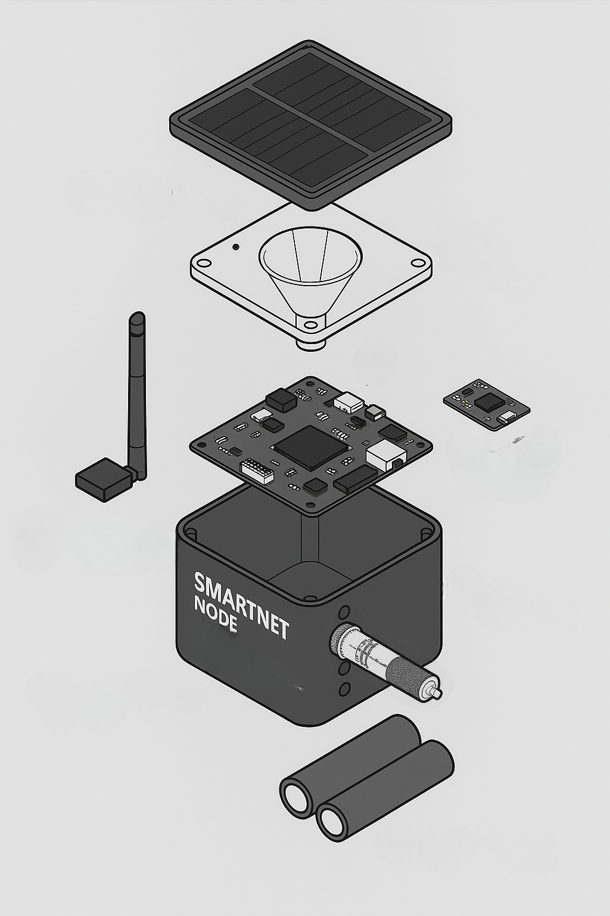
Solar Panel Mini
Top Cover
Bluetooth Module
Bluetooth Anthena 5.1
Microcontroller
Main Cover (IP67)
Risk Indicator (Merah, Kuning, Hijau)
Main Screen & Display data
Conductivity Sensor
Control Button
Lion Battery

Slide 2
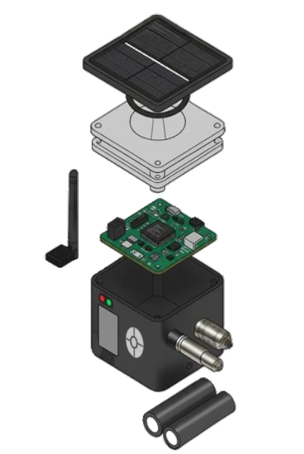
Top protector
Shockbreaker
Inner Protector
Local Storage
Bluetooth Anthena
Sensor Data
SMARTNET v1.0
Microcontroller
T = 30°C
WS = 10 knot
WND = 135° (SE)
pH = 7
S = 5.5
WVD = 90° (E)
Back
Pressure Sensor
Risk Indicator
Main Casing
Aplication Status
Temperature Sensor
Main Screen
Control Button
Conductivity Sensor
Lion Battery

Slide 3
Sensor Data
SMARTNET v1.0
T = 30°C
WS = 10 knot
WND = 135° (SE)
pH = 7
S = 5.5
WVD = 90° (E)
Back

